Slide 1


SOFTWARE ENGINEERING (Week-5)
Usama Musharaf
Lecturer (Department of Computer Science)
FAST-NUCES Peshawar

Slide 2
Contents of week # 5
Distributed Software Architecture
Client Server
Peer to Peer
REST
SOA
Microservices
Cloud Architecture

Slide 3
Categories of Architectural Styles
Hierarchical Software Architecture
Layered
Data Flow Software Architecture
Pipe and Filter
Batch Sequential
Data Centered Software Architecture
Black board
Shared Repository
Component-Based Software Architecture
Distributed Software Architecture
Client Server
Peer to Peer
REST
SOA
Microservices
Cloud Architecture
Event Based Software Architecture

Slide 4
distributed software architecture

Slide 5
Distributed Software Architecture
A distributed system is a collection of computational and storage devices connected through a communications network.
Data, software, and users are distributed.

Slide 6
Client Server Architectural Style

Slide 7
Client Server Architectural Style
Client/server architecture illustrates the relationship between two computer programs in which one program is a client, and the other is Server.
Client makes a service request to server.
Server provides service to the request.

Slide 8
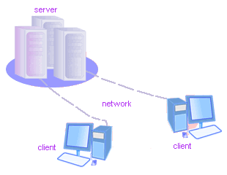
Client/Server
Although the client/server architecture can be used within a single computer by programs, but it is a more important idea in a network.
In a network, the client/server architecture allows efficient way to interconnect programs that are distributed efficiently across different locations.

Slide 9
Client-Server Style
Suitable for applications that involve distributed data and processing across a range of components.
Components:
Servers: Stand-alone components that provide specific services such as printing, data management, etc.
Clients: Components that call on the services provided by servers.
Connector: The network, which allows clients to access remote servers.

Slide 10
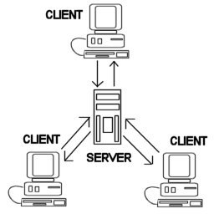
Common Example
The World Wide Web is an example of client-server architecture.
Each computer that uses a Web browser is a client, and the data on the various Web pages that those clients access is stored on multiple servers.

Slide 11
Another Example
If you have to check a bank account from your computer, you have to send a request to a server program at the bank.
That program processes the request and forwards the request to its own client program that sends a request to a database server at another bank computer to retrieve client balance information.
The balance is sent back to the bank data client, which in turn serves it back to your personal computer, which displays the information of balance on your computer.

Slide 12
Types of Servers
File Servers:
Useful for sharing files across a network.
The client passes requests for files over the network to the file server.
Database Servers:
Client passes SQL requests as messages to the DB server; results are returned over the network to the client.
Query processing done by the server.
No need for large data transfers.

Slide 13
Multi-tier Client server architecture

Slide 14
Types of Client Server
Two-tier client–server architecture,
which is used for simple client–server systems, and in situations where it is important to centralize the system for security reasons.
In such cases, communication between the client and server is normally encrypted.
Multitier client–server architecture,
which is used when there is a high volume of transactions to be processed by the server.

Slide 15
A two-tier client–server architecture
The system is implemented as a single logical server plus an indefinite number of clients that use that server.
Two forms of this architectural model:
A thin-client model,
A fat-client model,

Slide 16
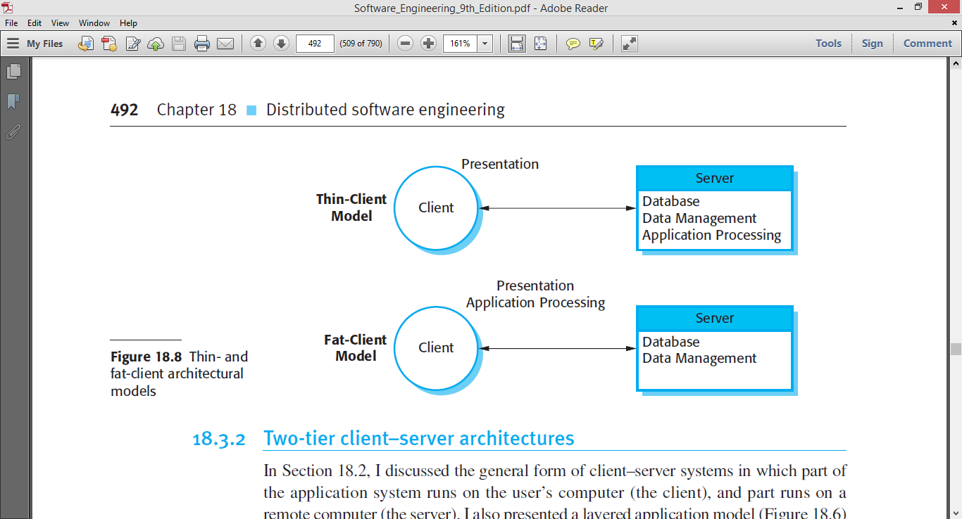
Two-tier Client Server
A thin-client model,
where the presentation layer is implemented on the client and all other layers (data management, application processing, and database) are implemented on a server.

Slide 17
Advantages
The advantage of the thin-client model is that it is simple to manage the clients.
This is a major issue if there are a large number of clients, as it may be difficult and expensive to install new software on all of them. If a web browser is used as the client, there is no need to install any software.

Slide 18
Disadvantages
The disadvantage of the thin-client approach, however is that it may place a heavy processing load on both the server and the network.
The server is responsible for all computation and this may lead to the generation of significant network traffic between the client and the server.

Slide 19
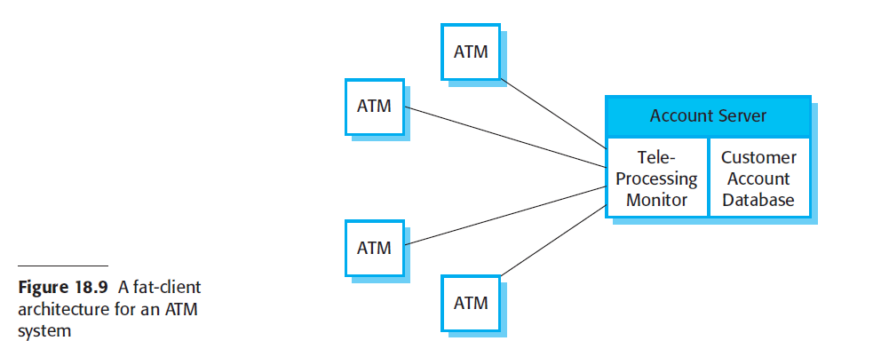
Two-tier Client Server
A fat-client model,
where some or all of the application processing is carried out on the client.
Data management and database functions are implemented on the server.

Slide 20
Multi-tier client–server architectures
The fundamental problem with a two-tier client–server approach is that the logical layers in the system—presentation, application processing, data management, and database—must be mapped onto two computer systems: the client and the server.
This may lead to problems with scalability and performance if the thin-client model is chosen, or problems of system management if the fat-client model is used.

Slide 21
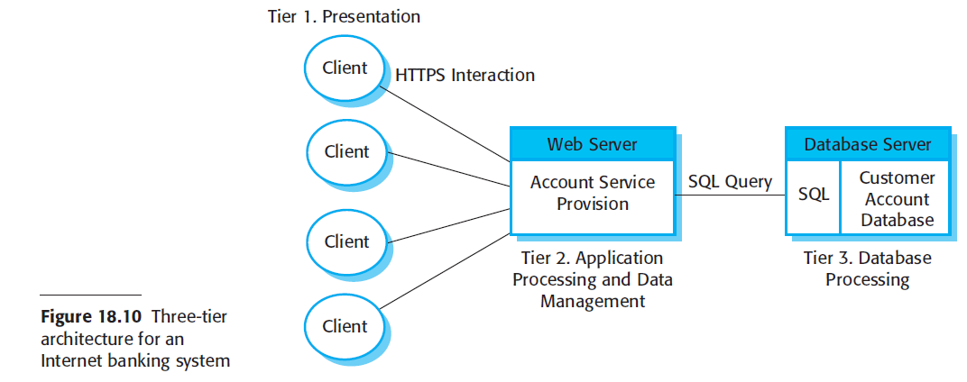
Multi-tier client–server architectures

Slide 22
Multi-tier client–server architectures
This system is scalable because it is relatively easy to add servers (scale out) as the number of customers increase.
In this case, the use of a three-tier architecture allows the information transfer between the web server and the database server to be optimized.

Slide 23
REST architecture

Slide 24
Representational state transfer (REST)
REST, or REpresentational State Transfer, is an architectural style for providing standards between computer systems on the web, making it easier for systems to communicate with each other.
REST is a guideline for building performant and scalable applications.

Slide 25
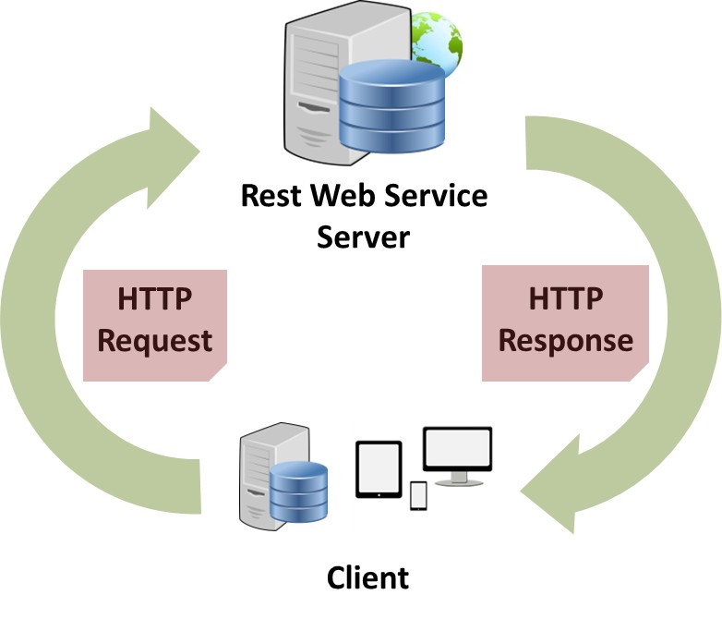
Representational State Transfer (REST)
Representational State Transfer (REST)
A style of software architecture for distributed systems such as the World Wide Web.
REST is basically client/server architectural style
Requests and responses are built around the transfer of "representations" of "resources".
HTTP is the main and the best example of a REST style implementation
But it should not be confused with REST
REST is not a protocol
REST is a guideline

Slide 26
REST principles / architectural constraints
Client-server
Stateless
Cacheable
Uniform interface
Layered system
Code on demand (optional)

Slide 27
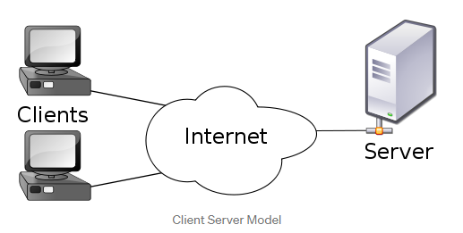
1. Client Server
Separation of concerns is the principle behind the client-server constraints.
By separating the user interface concerns from the data storage concerns, we improve the portability of the user interface across multiple platforms and improve scalability by simplifying the server components.
Client and server can evolve independently.

Slide 28
2. stateless
Statelessness means communication must be stateless in nature as in the client stateless server style,
Each request from client to server must contain all of the information necessary to understand the request, and cannot take advantage of any stored context on the server.

Slide 29
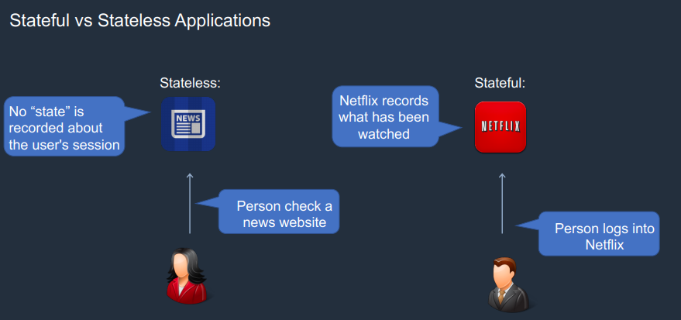

Slide 30
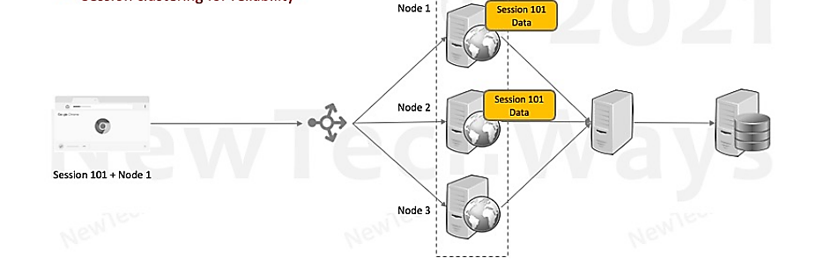
stateful

Slide 31
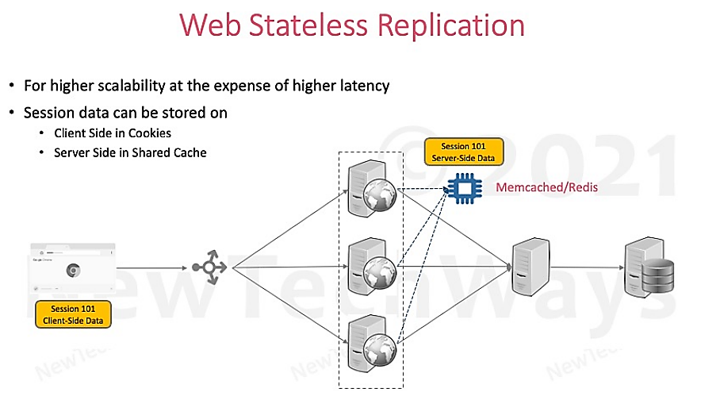
stateless

Slide 32
3. cacheable
In order to improve network efficiency, cache constraints are added to the REST style.
Cache constraints require that the data within a response to a request can be cacheable or not
If a response is cacheable, then a client cache is given the right to reuse that response data for later, equivalent requests.
The advantage of adding cache constraints is that they have the potential to partially or completely eliminate some interactions, improving efficiency, scalability, and user-perceived performance by reducing the average latency of a series of interactions.

Slide 33
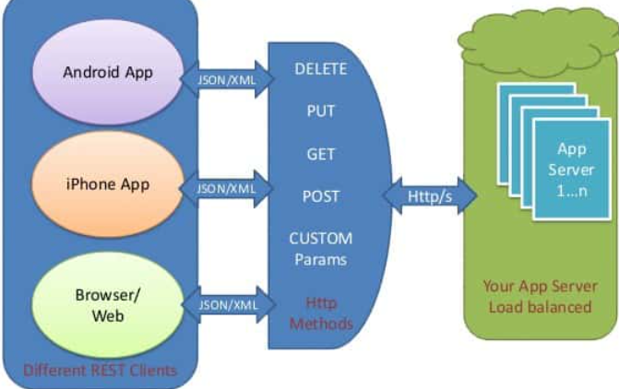
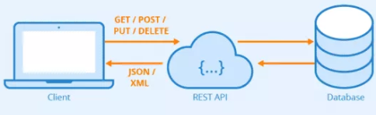
4. Uniform interface
Identification of resources (typically by URI).
Manipulation of resources through representations.

Slide 34
5. Layered system
The layered system style allows an architecture to be composed of hierarchical layers by constraining component behavior such that each component cannot “see” beyond the immediate layer with which they are interacting.

Slide 35
6. Code on demand (optional)
This states that the server can add more functionality to the REST client, by sending code that can be executable by that client. In the context of the web, one such example is JavaScript code that the server sends to the browser.
For example, a web browser acts like a REST client and the server passes HTML content that the browser renders. At the server side, there is some sort of server-side language which is performing some logical work at the server side. But if we want to add some logic which will work in the browser then we (as server-side developers) will have to send some JavaScript code to the client side and the browser and then execute that JavaScript.

Slide 36
Service Oriented architecture (SOA)

Slide 37
Service oriented architecture (soa)
A service-oriented architecture (SOA) is an architectural pattern in computer software design in which application components provide services to other components via a communications protocol, typically over a network.
The principles of service-orientation are independent of any product, vendor or technology.

Slide 38
What is Service?
A service is a self-contained, self-describing and modular piece of software that performs a specific business function such as validating a credit card or generating an invoice.
The term self-contained implies services include all that is needed to get them working.
Self-describing means they have interfaces that describe their business functionalities.
Modular means services can be aggregated to form more complex applications.

Slide 39
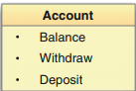
Example
A single service provides a collection of capabilities, often grouped together within a functional context as established by business requirements.
For example, the functional context of the service below is account. Therefore, this service provides the set of operations associated with a customer’s account.

Slide 40
Banking example
Imagine that several areas of banking applications will deal with the current balance of an existing customer.
More than often, the “get current balance” functionality is repeated in various applications within a banking environment.
This gives rise to a redundant programming scenario.
The focus should be toward finding this sort of common, reusable functionality and implement it as a service, so
that all banking applications can reuse the service as and when necessary.

Slide 41
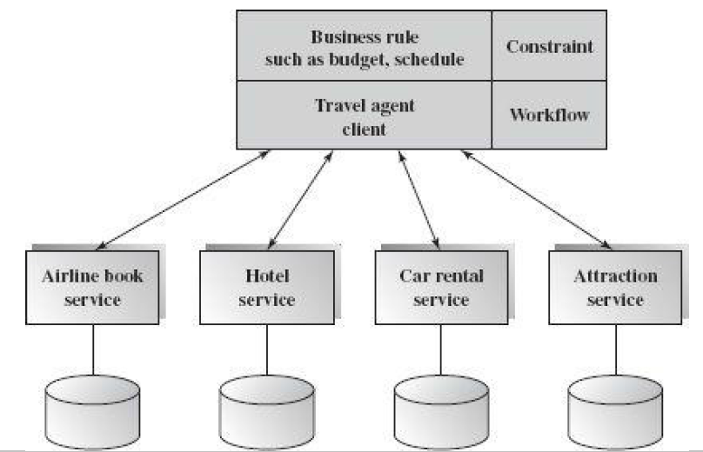
example
An online travel agency system
It consists of four existing web services:
airline reservation,
car rental,
hotel reservation,
and attraction reservation.

Slide 42
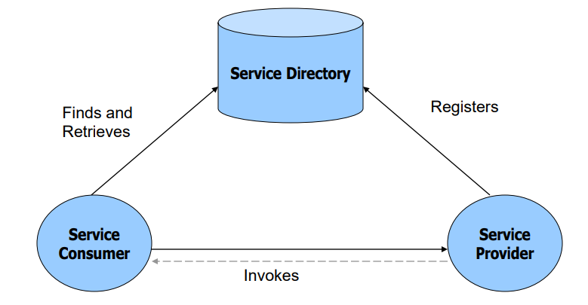
SOA Architecture

Slide 43
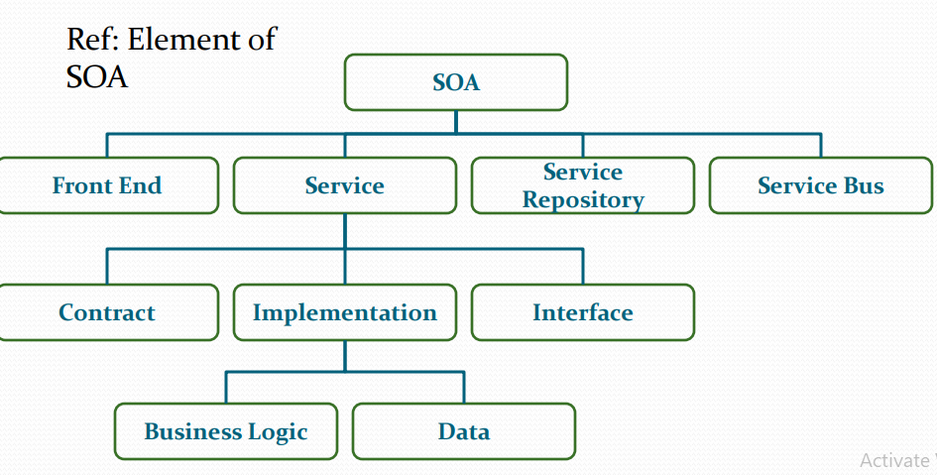
Components of SOA

Slide 44
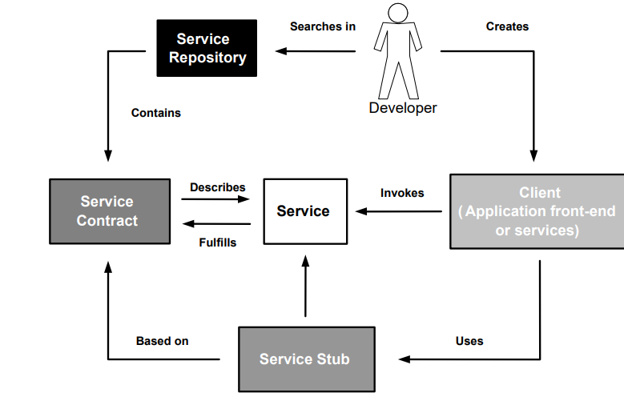

Slide 45
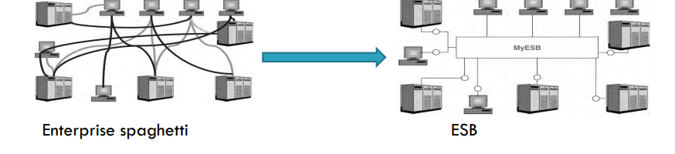
ESB
Enterprise Service Buses (ESBs) build on MOM (message-oriented middleware) to provide a flexible, scalable, standards-based integration technology for building a loosely coupled, highly-distributed SOA

Slide 46
Service Composition

Slide 47
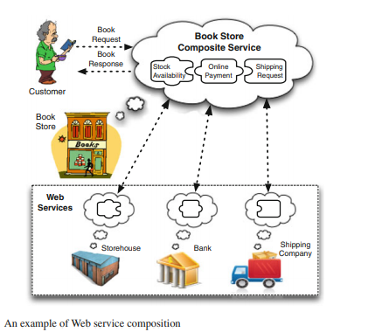

Slide 48
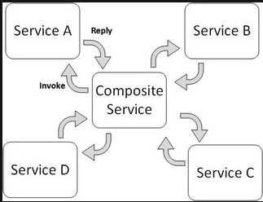
Service Orchestration vs Service choreography
Orchestration comes from orchestras; in an orchestra there is a conductor leading it, and there are musicians who play their instruments following the instructions of the conductor.
The musicians know their role; they know how to play their instruments, but not necessarily directly interact with each other. That is, in an orchestra, there is a central system (the conductor) that coordinates and synchronizes the interactions of the components to perform a coherent piece of music.

Slide 49
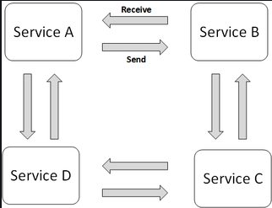
Service Orchestration vs Service choreography
Choreography is related to dance; on a dancing stage there are just dancers, but they know what they have to do and how to interact with the other dancers; each dancer is in charge of being synchronized with the rest.

Slide 50
Microservices

Slide 51
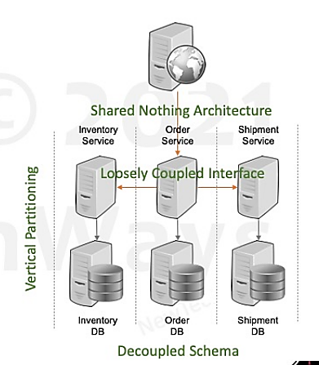
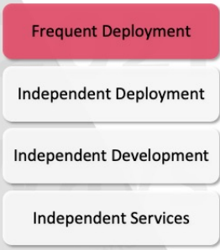
Microservices
Microservices are small, individually deployable services performing different operations.
Variant of SOA

Slide 52
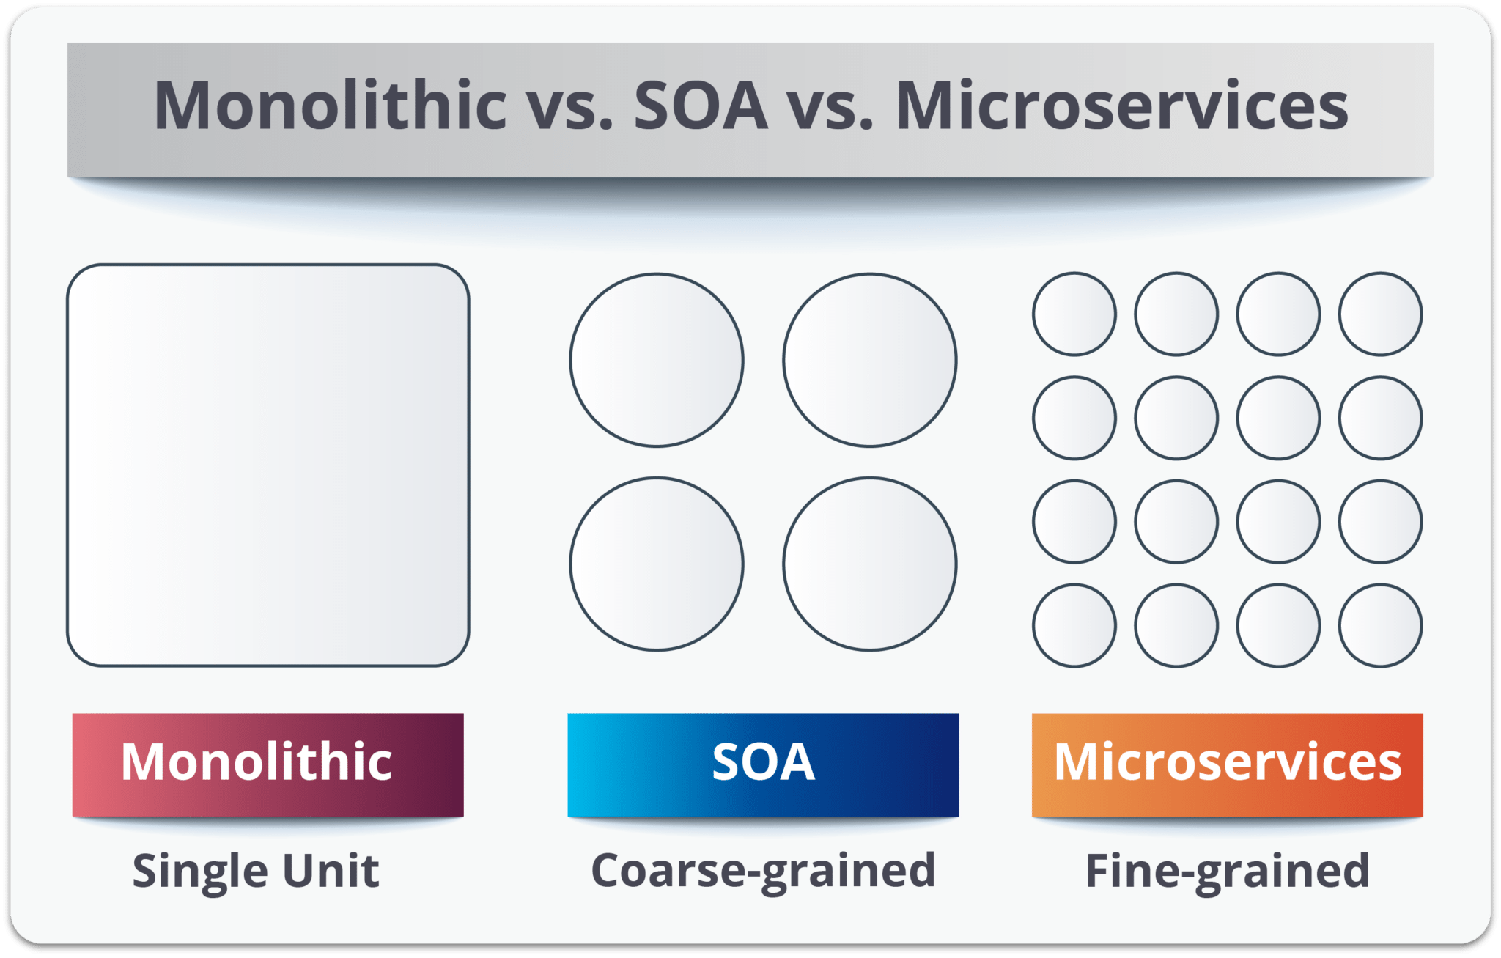
SOA vs microservices

Slide 53
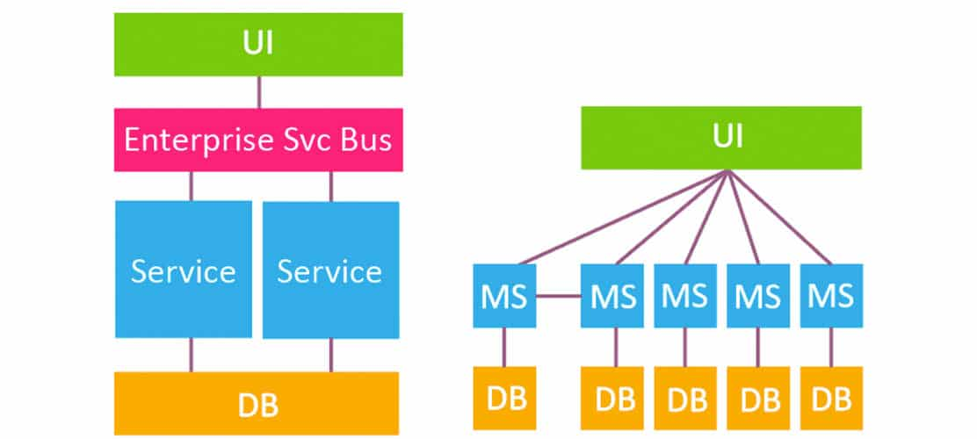
SOA vs microservices

Slide 54
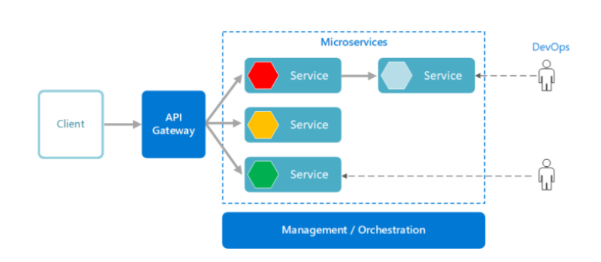
How does Microservices architecture work?

Slide 55
Communication in Microservices
Synchronous Messages:
In the situation where clients wait for the responses from a service, Microservices usually tend to use REST (Representational State Transfer) as it relies on a stateless, client-server, and the HTTP protocol. This protocol is used as it is a distributed environment each and every functionality is represented with a resource to carry out operations
Asynchronous Messages:
In the situation where clients do not wait for the responses from a service, Microservices usually tend to use protocols such as AMQP, MQTT.

Slide 56
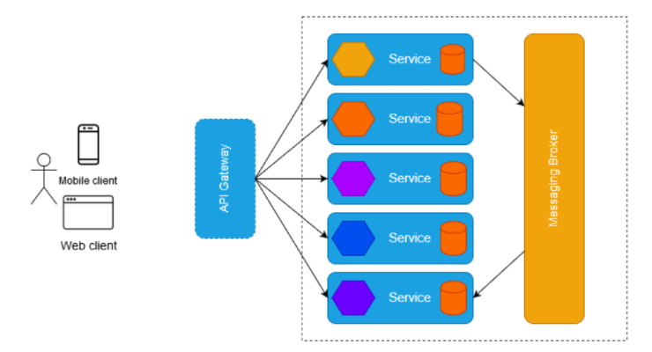
Reference architecture of Microservices

Slide 57
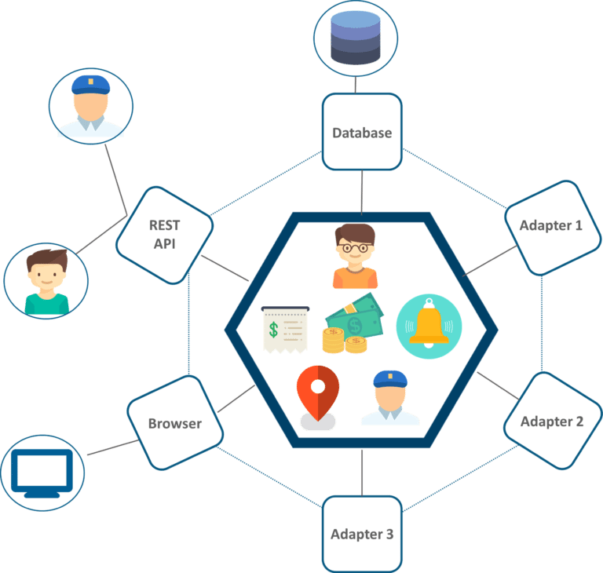
Uber’s previous architecture
A REST API is present with which the passenger and driver connect.
Three different adapters are used with API within them, to perform actions such as billing, payments, sending emails/messages that we see when we book a cab.
A MySQL database to store all their data.
All the features such as passenger management, billing, notification features, payments, trip management, and driver management were composed within a single framework.

Slide 58
Problem in uber’s architecture
All the features had to be re-built, deployed and tested again and again to update a single feature.
Fixing bugs became extremely difficult in a single repository as developers had to change the code again and again.
Scaling the features simultaneously with the introduction of new features was quite tough to be handled together.

Slide 59
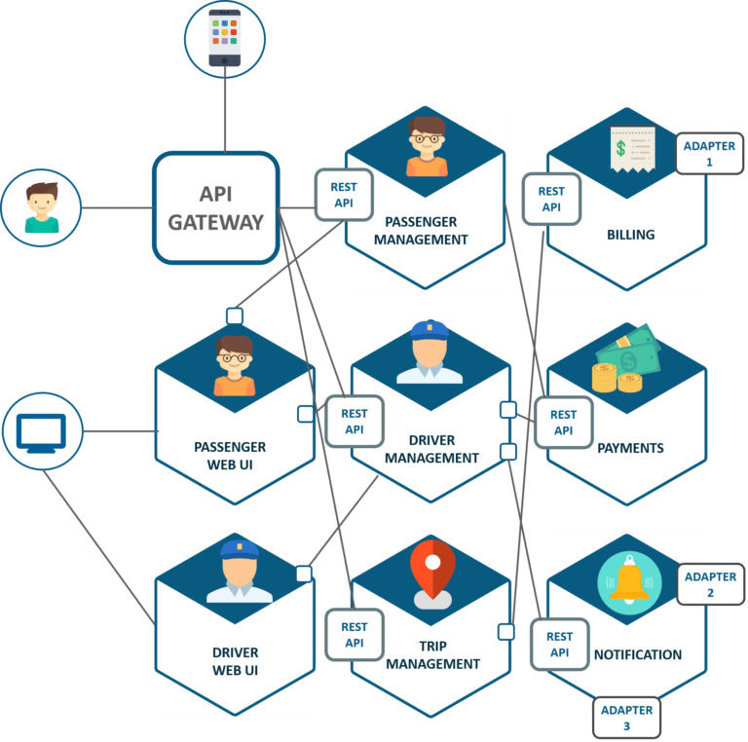
Solution is Microservices architecture

Slide 60
Solution
The units are individual separate deployable units performing separate functionalities.
For Example: If you want to change anything in the billing Microservices, then you just have to deploy only billing Microservices and don’t have to deploy the others.
All the features were now scaled individually i.e. The interdependency between each and every feature was removed.

Slide 61
Decomposition of microservices
There are some Prerequisite of decomposition of microservices.
Services must be cohesive.
A service should implement a small set of strongly related functions.
Services must be loosely coupled
Each service as an API that encapsulates its implementation.

Slide 62
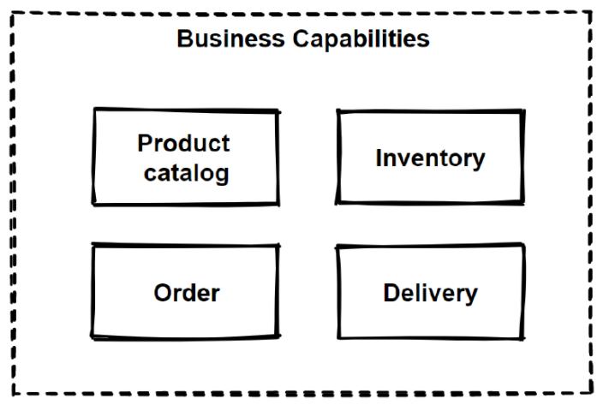
Decomposition of microservices
Decompose by Business Capability” pattern offers that;
Define services corresponding to business capabilities.
A business capability is a concept from business architecture modeling.
A business service should generate value.
For example; Order Management is responsible for orders, Customer Management is responsible for customers.

Slide 63
Cloud architecture

Slide 64
Cloud computing
Cloud computing is the on-demand availability of computer system resources, especially data storage and computing power, without direct active management by the user.

Slide 65
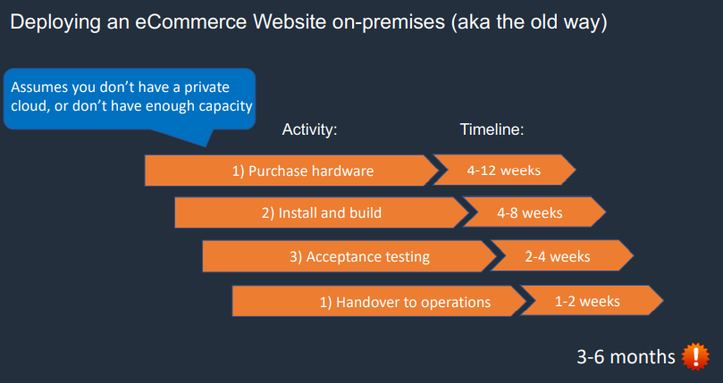

Slide 66
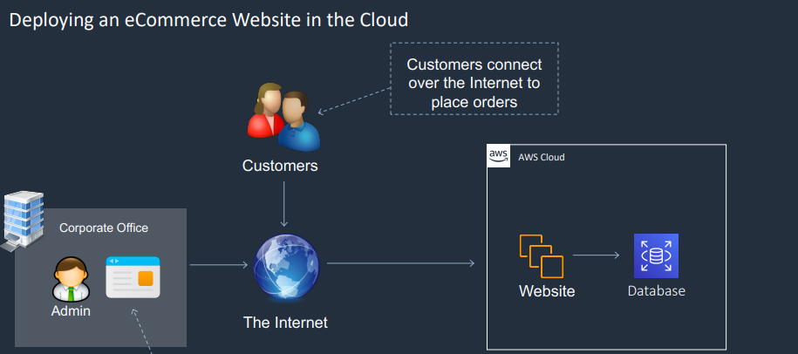

Slide 67
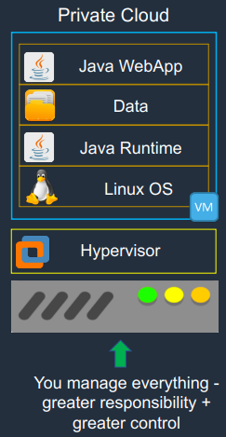
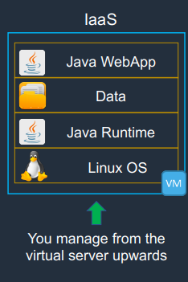
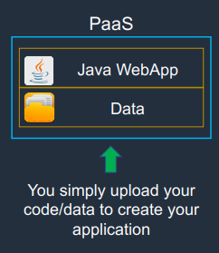
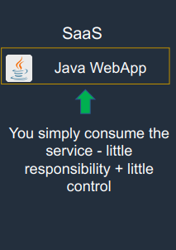
Cloud service models: comparison

Slide 68
HAVE A GOOD DAY!

